Slide 1
Price Monitoring Application
By
Rishabh Singh

Slide 2
ABSTRACT
This project aims to develop a web application that can track prices of products on Amazon.
It sends the user an e-mail notification when the price of a specific product decreases according to the users’ specification.
It helps customers to know the price of the product when it reaches their required needs and immediately notifies them.
Customers can copy the product link on the application which automatically starts tracking the product price.

Slide 3
Existing System
Most of the software’s currently being used in the Industry are mainly focused over earning profits through hiding software’s behind pay walls.
And mostly there are casual customers like ourselves who don’t require the need for a highly advanced form of a price tracker.
The current price trackers are for tracking hundreds of products at a single time.
Two famous applications are:
Keepa
AliExpress Price Tracker

Slide 4
Disadvantages of Existing System
The existing system poses the following limitations:
Data Analysis
Time consuming
Protection policies
Paid on basis

Slide 5
Proposed System
Software will use basic web scraping modules.
Not hidden behind pay walls.
Casual and satisfying experience while tracking their favorite products across the web.
Users don’t have to keep on logging on to Amazon.
Trustworthy application to automatically track product prices .
Sends an email notification.

Slide 6
What is Web Scraping ?
Web scraping used for extracting data from websites.
Web scraping software accesses the World Wide Web using Hypertext Transfer Protocol.
It refers to automated processes implemented using a bot or web crawler.
Web scraping a web page involves fetching it and extracting from it.

Slide 7
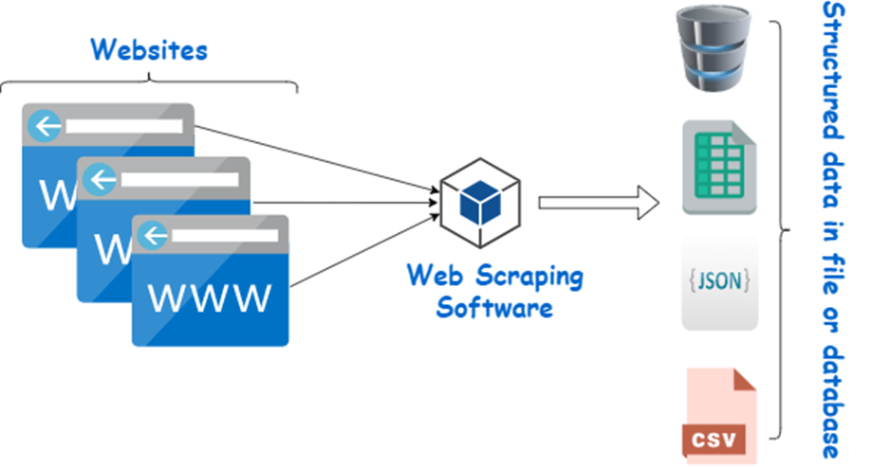
Fig: Web Scraping Process Over view

Slide 8
Software and Hardware Requirements
Software Requirement:
Python
Visual Studio Code
XAMPP
Windows OS
Hardware Requirement:
For Development:
Personal computer having Intel Pentium 4.2.66Hz processor or higher.
Minimum 1 GB RAM
User Requirement:
Any personal computer system
Internet Connectivity

Slide 9
Application Architecture
Amazon Website
1.User goes to Amazon
User
2.User takes URL from website
3. Inserts URL into
application
4.Goes to allocated URL
5.Extracts Price ID
6.Notifies user through email if price drop occurs
Price Monitoring

Slide 10
Price Monitoring Algorthim
Step 1: Start
Step 2: Declare variables Price, Email Address & URL.
Step 3: Read variables Price, Email Address & URL.
Step 4: Extract Price ID from URL.
Step 5: Compare extracted price from URL with the price provided by the user as a variable.
Step 6: Check if extracted price less than price provided by the user.
Step 7: If step 6 is true then initialize email server.
Step 8: Send email with the message “Price Dropped”
Step 9: Stop

Slide 11
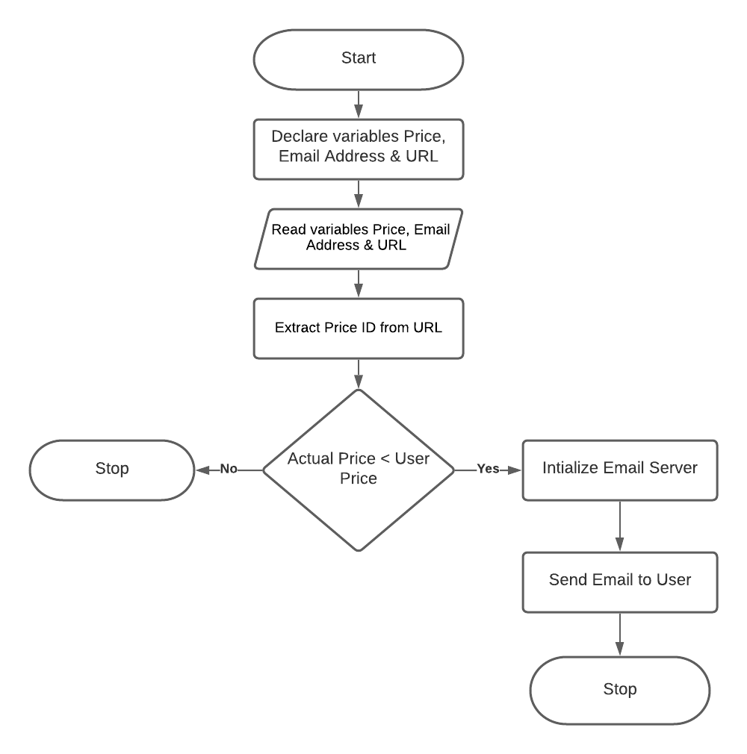
Price Monitoring Flow Chart

Slide 12
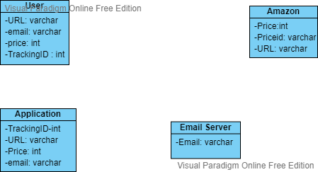
UML Class Diagram

Slide 13
Modules
Modules used in this Application are :
GUI Screen
Web Scraping Module
Database Module
Email Server Module

Slide 14
Application
GUI Module
Web Scraping Module
Email Server Module
Database Module

Slide 15
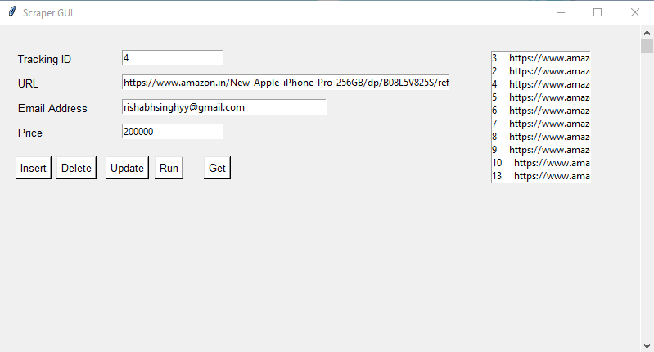
GUI Screen
User must enter Tracking ID , URL, E-mail and Price of the product he/she wants to buy at.

Slide 16
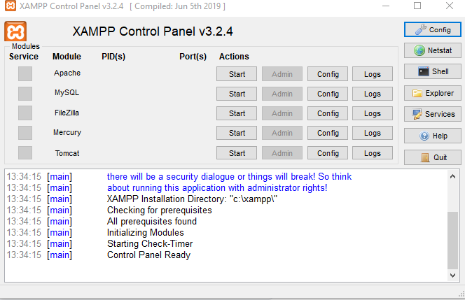
Database Module
This module is implemented using XAMPP to establish a connection between application and database.

Slide 17
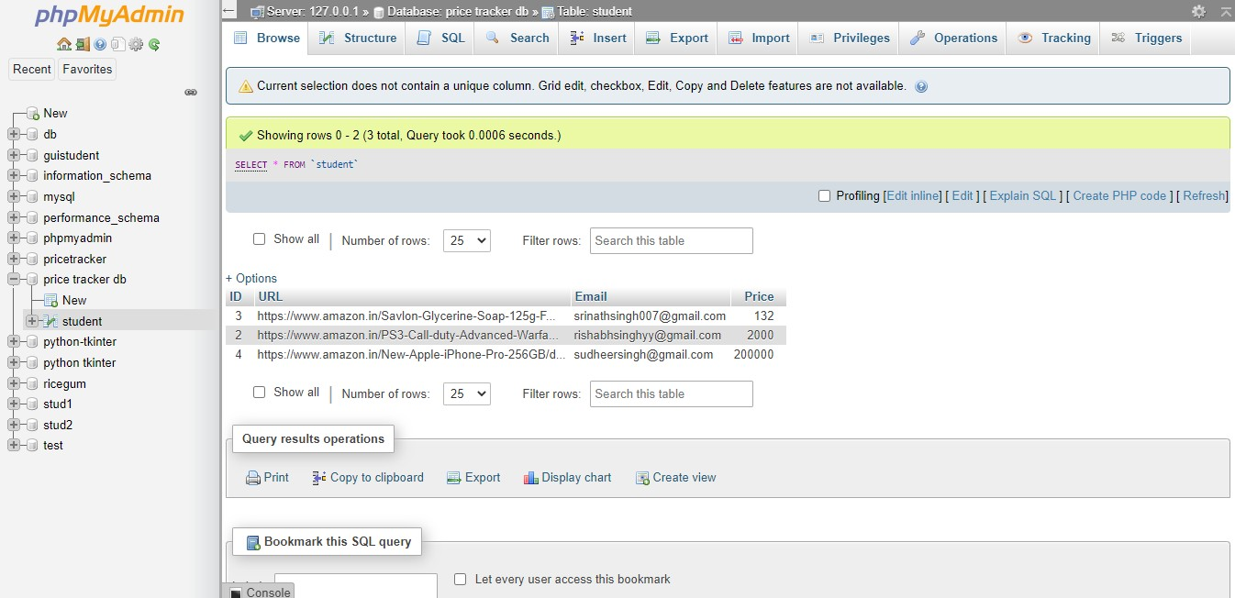
Fig: Database using XAMPP

Slide 18
Web Scraping Modules
Requests
It is a simple python web scraping library. It is an efficient HTTP library used for accessing web pages. With the help of Requests, we can get the raw HTML of web pages which can then be parsed for retrieving the data. Before using requests, let us understand its installation.
Beautiful Soup
is a Python package for parsing HTML and XML documents. It creates a parse tree for parsed pages that can be used to extract data from HTML, which is useful for web scraping.

Slide 19
Email Server Module
This is the Email Server module which is used to establish a email server to send email to the user notifying a drop in price of product.
#Function will send email
#Author : Rishabh Singh and SVIT Price Monitoring APP Team
def send_mail(Email_Param, URL_Param):
server = smtplib.SMTP('smtp.gmail.com', 587) server.ehlo()
server.starttls() server.ehlo
server.login('rishabhsinghyy@gmail.com', 'ixkicvutadbfp jim')
subject='Price fell down'
body = "Check the URL Link :" + URL_Param msg = f"Subject: {subject}\n\n{body}"
server.sendmail('rishabhsinghyy@gmail.com', Email_Param
, msg )
MessageBox.showinfo("Message is sent To : ",Email_Param
);
server.quit()

Slide 20
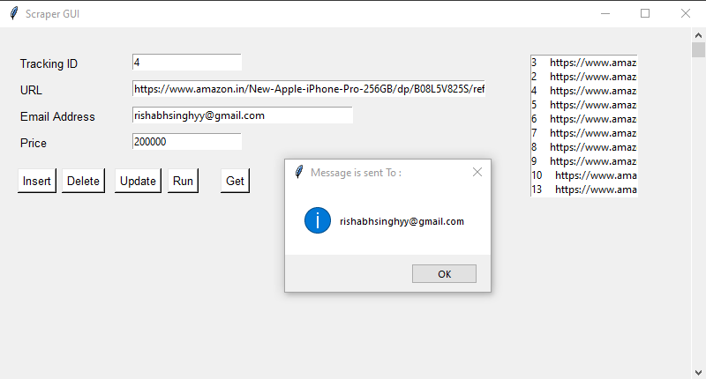
Output
Fig: Email sent to User’s Email ID

Slide 21
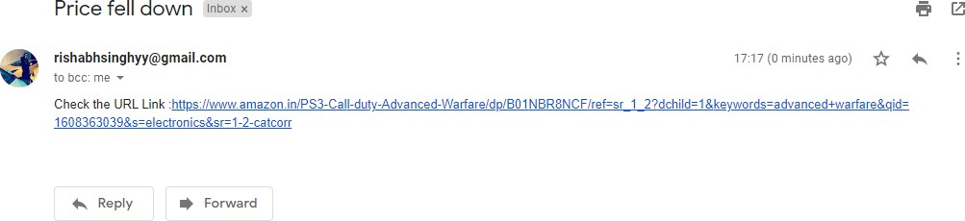
Fig: Email in Inbox

Slide 22
Conclusion
This Price Monitoring application developed by us is a small-scale model of a price tracker which can be used by users looking for a casual experience to track any product on Amazon.
Price tracking software can prove to be a vital asset to your pricing process by giving you key market insights to base your pricing strategy.

Slide 23
THANK YOU

